Slide 1




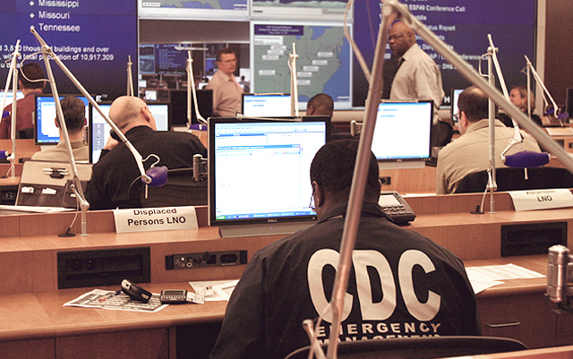
CDC Incident Management System (IMS) and Emergency Operation Center
Centers for Disease Control and Prevention
Office of Public Health Preparedness and Response

Slide 2



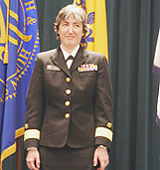


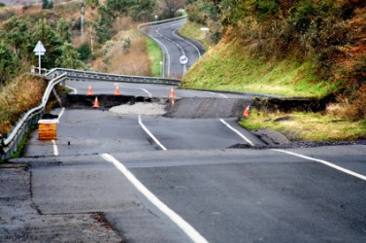
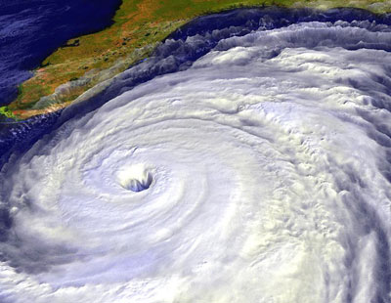

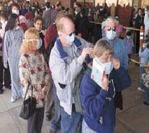
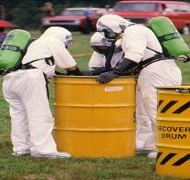
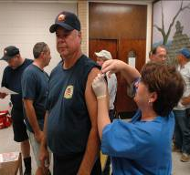
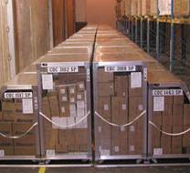

Purpose
To provide an information briefing on the
CDC Incident Management System (IMS) and CDC Emergency Operations Center

Slide 3
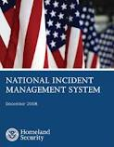
Our Agenda
National Incident Management System
Federal Guidance
CDC Incident Management System
CDC Incident Response Process
CDC Incident Response Structure
CDC Emergency Operations Center

Slide 4


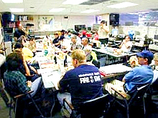
Principles of the National Incident Management System (NIMS)
NIMS is a comprehensive, national approach to incident management
NIMS provides the template for incident management, regardless of cause, size, location, or complexity
NIMS is applicable at all jurisdictional levels and across functional disciplines

Slide 5
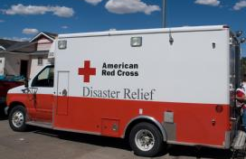
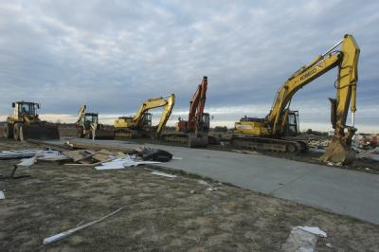
Benefits of the National Incident Management System
Standardized approach to incident management that is scalable and flexible
Enhanced cooperation and interoperability among responders
Comprehensive all-hazards preparedness
Efficient resource coordination among jurisdictions or organizations
Reflects best practices and lessons learned

Slide 6












National Response Framework
15 ESFs
1: Transportation Department of Transportation | 6: Mass Care, Emergency Assistance, Housing and Human Services Department of Homeland Security / Federal Emergency Management Agency | 11: Agriculture and Natural Resource Department of Agriculture / Department of the Interior
2: Communications National Communications System | 7: Logistics Management and Resource Support Department of Homeland Security / Federal Emergency Management Agency / General Services Admin | 12: Energy Department of Energy
3: Public Works & Engineering Department of Defense/ Army Corps of Engineers | 8: Public Health and Medical Services Department of Health and Human Services | 13: Public Safety and Security Department of Justice
4: Firefighting Department of Agriculture/ Forest Service | 9: Search and Rescue Department of Homeland Security / Federal Emergency Management Agency / U.S. Coast Guard / Department of the Interior | 14: Long-Term Community Recovery Department of Agriculture / DHS / FEMA / Small Business Administration
5: Emergency Management Department of Homeland Security / Federal Emergency Management Agency | 10: Oil and Hazardous Materials Response Department of Homeland Security / U.S. Coast Guard / Environmental Protection Agency | 15: Emergency Public Information and External Communications DHS / FEMA

Slide 7
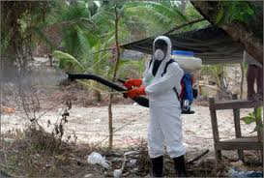
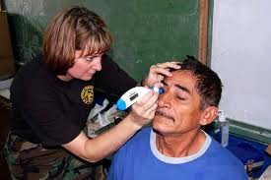
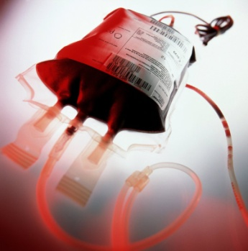
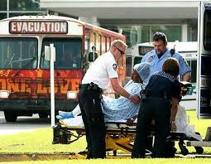
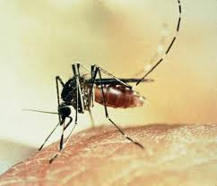
ESF #8: Functions
  Public health and medical needs assessment
  Public health surveillance
  Medical care personnel deployment
  Medical equipment and supplies distribution
  Patient evacuation and care
  Safety and security
  Blood, organ, and blood tissue needs
  Behavioral health care
  Public health and medical information
  Vector control
  Mass fatality management
  Veterinary medical support
  Public health aspects of potable water/wastewater and solid waste

Slide 8
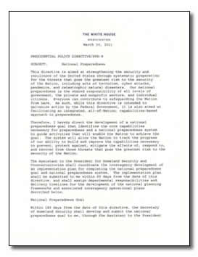
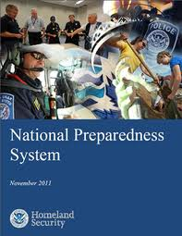


Federal Guidance
Presidential Policy Directive #8 (National Preparedness)
Homeland Security Preparedness Directives
National Preparedness System and National Preparedness Goal
National Frameworks
  Prevention
  Protection
  Response
  Mitigation
  Recovery
National Plans
National Incident Management System

Slide 9
National Plans Cascade
Presidential Policy Directive 8 (PPD-8)
National Preparedness (PPD-8): describes the Nation’s approach to preparing for the threats and hazards that pose the greatest risk to the security of the United States. The National Preparedness Goal sets the vision for preparedness nationwide and identifies the core capabilities and capability targets necessary to achieve that vision.
National Preparedness System
National Preparedness System: Designed to guide domestic efforts of all levels of government, the private and nonprofit sectors and the public,. Includes guidance for planning, organization, equipment, training and exercises needed to build and maintain domestic capabilities in support of the National Preparedness Goal.
National Frameworks
National Level Frameworks : focused on preparing capabilities and federal interagency operational plans to deliver capabilities. The five frameworks: are Prevention, Protection, Response, Recovery, Mitigation
Federal Interagency CONPLANs
Federal Interagency CONPLANs: The Federal interagency CONPLANs support each National Planning Framework with corresponding planning guidance for State, local, tribal and territorial governments.
Federal Department and Agency OPLANs
Department and Agency Operations Plans: The OPLANs describe the Federal department’s or agency’s specific responsibilities for the wide range of threats and hazards that pose a significant risk to the Nation.
Secretary’s Playbooks
Secretary’s Playbooks: The Playbooks are detailed checklists for executives that the Secretary of Health and Human Services issues to ensure a coordinated response to the wide range of threats and hazards that pose a significant risk to the Nation.
CDC
OPLANs
CDC OPLANs: CDC maintains the base document “Emergency Operations Plan” and specific high- consequence threat annexes.

Slide 10

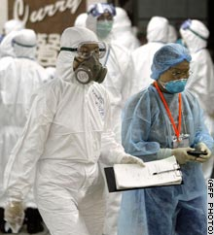

Public Health
Preparedness
The capacity of the public health system, communities, and individuals to prevent and protect against, mitigate against, quickly respond to, and recover from health emergencies, particularly those in which scale, timing, and unpredictability threaten to overwhelm routine capabilities, regardless of their cause.

Slide 11
The
CDC Incident
Management System

Slide 12
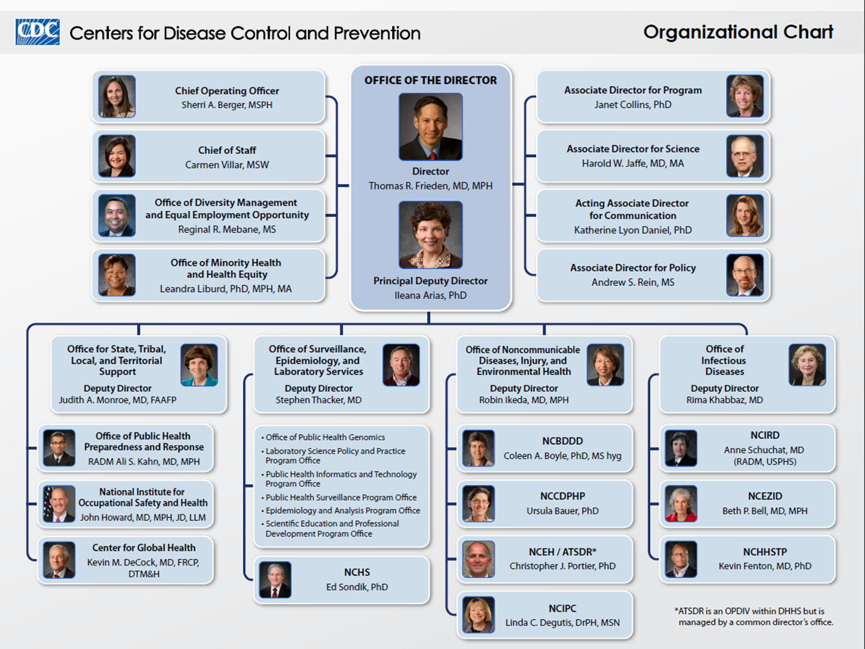
Centers for Disease Control and Prevention

Slide 13
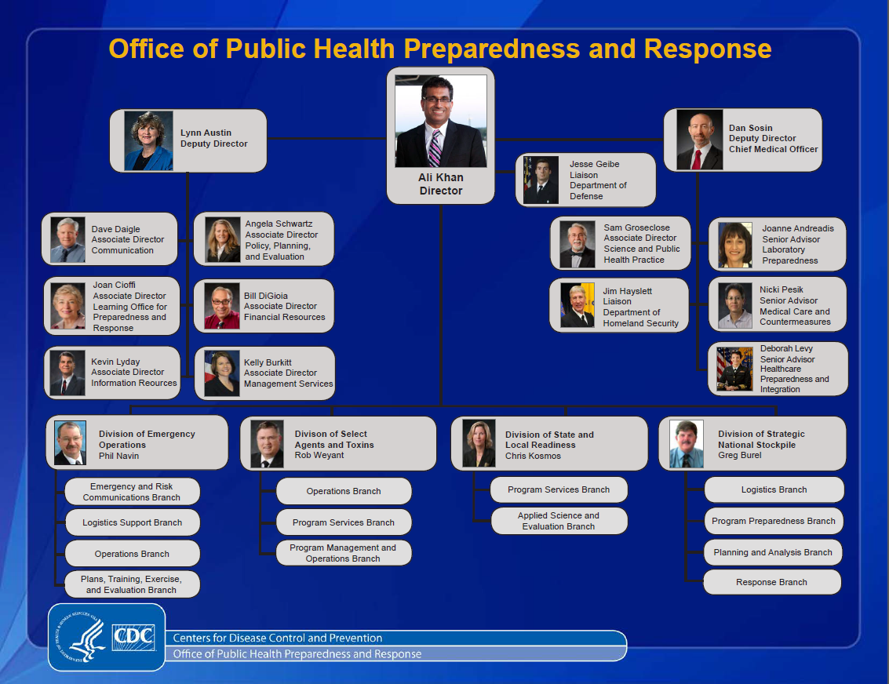

Slide 14
Notification Process

Slide 15
EOC Activation Process
Event Occurs
Reported by External Partners
Detected by Internal Programs
CDC EOC
Notifies CDC Leadership
Contacts
CIO SME
Convenes
“Preliminary Assessment Team” Assess situation and requirements
Key Leaders
CDC CIO
Response is
handled by
CDC program
Recommend
Activation of the
CDC EOC
NO
Do we need EOC IMS?
YES

Slide 16
Director’s Critical Information Requirements (DCIRs)
Some DCIRs are internal to CDC:
  Accidental death or injury of CDC personnel
  Report events affecting CDC installation activities/operations
  Report incidents of international significance affecting CDC staff
Other DCIRs pertain to national and global events
  Report disease outbreaks/deaths that are above the base line for the seasonal or geographic norms
  Report any chemical, biological, nuclear threats or events-airborne releases, natural hazard or water.
DCIRs are also established for specific events or activations.

Slide 17
CDC Director’s Critical Information
Requirements (DCIRs)
Report disease outbreaks/deaths that are above the base line for the seasonal or geographic norm
Report DOH or physician inquires of suspected H5N1
Report confirmed bird/animal H5N1
Report any chemical, biological, nuclear threats or events-airborne releases, natural hazard or water
Media interest for any accidental or intentional agent or toxin release/use
Vaccine adverse affects resulting in death
Food borne illness resulting in above base line numbers
Accidental death/injury of CDC personnel
Request for use of CDC aircraft
Report any requests for SNS assets
Report events affecting CDC installation activities/operations
Report incidents of international significance affecting CDC staff
Significant theft, loss, accidental release or inventory discrepancy of select agents
* Note: DCIR’s become more detailed and change constantly once an event occurs

Slide 18
CDC Response
Significance of the event increases
Level
1
Awareness
(Steady-State)
Phase 1
Phase 2
Phase 3
AWARENESS/ RESPONSE
Response
Incident Manager
EOC Staffing
Deploy CDC Resources
Monitor Incident
IAP development
Gather intelligence
Report Information
On-Scene:
IRCT/SATA/ESF#8
Field teams manage deployed resources
Level
2
Staffing Increase
Alert
DEO Director:
CIO/ ATSDR SME Alerted
Mission Analysis Reviewed
Increased Activity:
Federal & State create COP
Conduct Planning-IAP
Deployment Preparation
Level
3
Watch
EOC Opns Chief
EOC Core Staff
Global Monitoring
Normal Operations
CDC Director’s Critical Information Requirements (DCIR)
Notes:
18

Slide 19
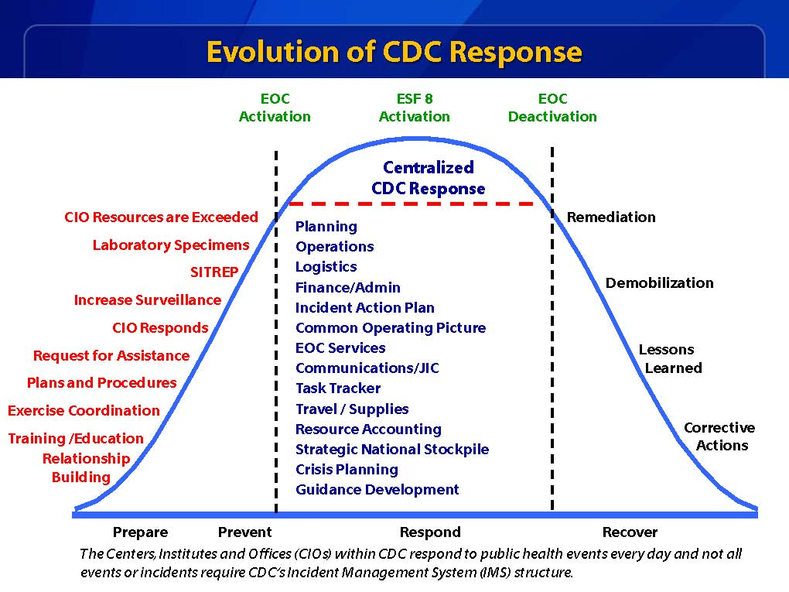

Slide 20
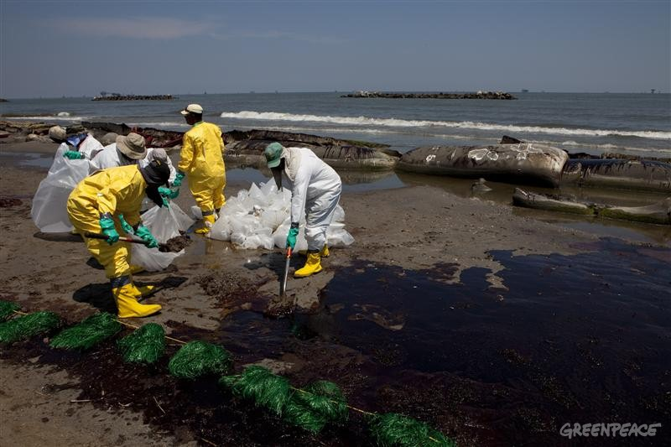
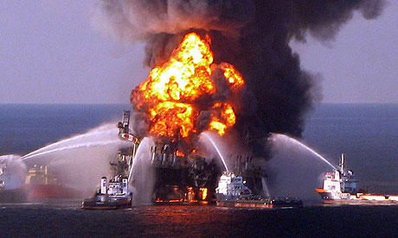
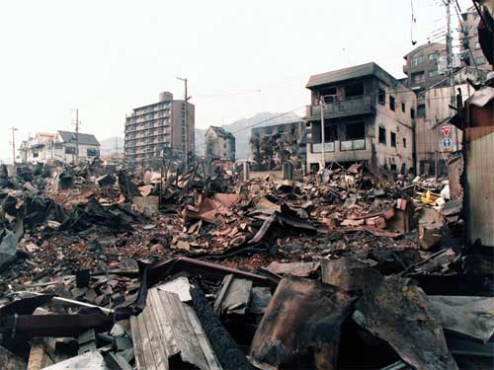
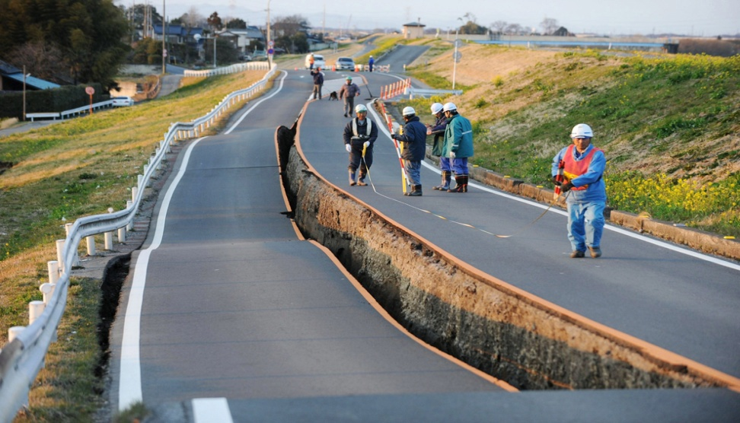
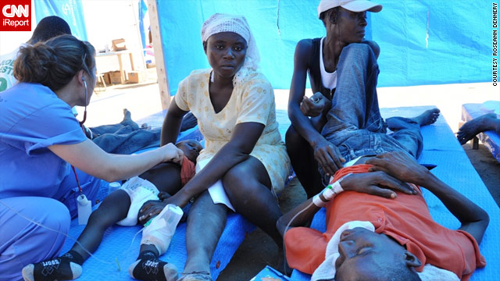
Examples of Past Events Requiring Interagency Collaboration

Slide 21
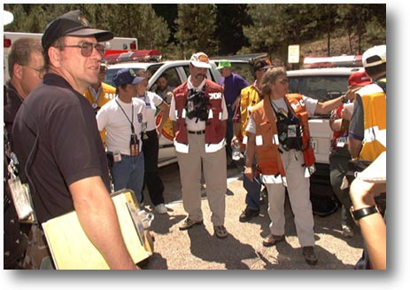
Incident Command vs. Management
Incident Command System (ICS): Field response
  On-scene control, decision authority
  Accountable for success or failure of efforts
Incident Management System (IMS) response:
  Coordinates information flow and response actions
  Provides scientific support, technical assistance, and resources

Slide 22
CDC Incident Management System
Organizational Chart

Slide 23

CDC IMS
Command Section
IAP
DSNS
CHO
Meetings
IM
CofS
OGC
EOMS
SA
LNO

Slide 24
Incident Manager (IM)
Obtains approval to activate the Incident
Management Structure.
Ensures relevant positions to support the level of response are filled with qualified personnel.
Maintains overall situational awareness of the event and all deployed CDC resources.
Obtains briefings on the incident and approves
briefings to be presented to the agency director.
Maintains awareness of Director’s Critical
Information Requirements (DCIR).
Briefs the Agency Director and key staff as required.
Approves the staff rhythm to be used during the event.
Establishes incident priorities; approves incident objectives.
Comes from the Primary Center responsible for event.
Notes:
As mentioned, within CDC we have an Incident manager, vice and Incident Commander. These are a few of the duties of the Incident Manager. Of note, the IM’s staff does assist him with most of these activities.
Recommend highlighting a few bullets only:
Obtains approval to activate the Incident Management Structure. Each activation is approved by the CDC Director.
Maintains overall situational awareness of the event and all deployed CDC resources. IM has an awareness of vertical and horizontal agency activities that other staff will not necessarily have access to.
Briefs the Agency Director and key staff. Discuss how Director’s Update Briefings are conducted and how information from them is disseminated.
Approves the staff rhythm to be used during the event. Discuss what a staff rhythm is.
Re-enforce and highlight that the IM usually comes from the Lead Center responsible of event.

Slide 25


Chief Health / Science Officer
Oversees the Scientific/Technical Response.
Advises the IM on scientific and health issues.
Defines qualifications for various types of CDC staff that may be deployed to fulfill a mission assignment to assure that scientific qualifications are met prior to deployment.
Reviews media releases and other documents in the clearance process for scientific accuracy.
Receives reports of scientific information from SMEs in the Scientific Response Section (SRS) and from CDC field teams.
Provides additional health and science advice to the command staff as required.
Notes:
Brings the senior level science expertise to the response.

Slide 26
Scientific Response Section (SRS)
Science based response SMEs (Subject Matter Experts)
Provides technical guidance to IM in response to requests
Coordinates to ensure response operations are scientifically based
Prepares data and reports for the Incident Action Plan
Develops and conducts scientific interventions/courses of action
Can vary in size from individuals to teams to task forces

Slide 27

Chief of Staff
Supervises and coordinates the details of the CDC IMS response.
Ensures the staff provides the IM updated estimates and plans for future actions.
Supervises the staff’s synchronization.
Supervises information flow in and out of the staff.
Oversees the General Staff support sections.
Notes:
Operationally based vs. science based
Focuses more on the internal operations
Oversees the General Staff support sections that are displayed next

Slide 28
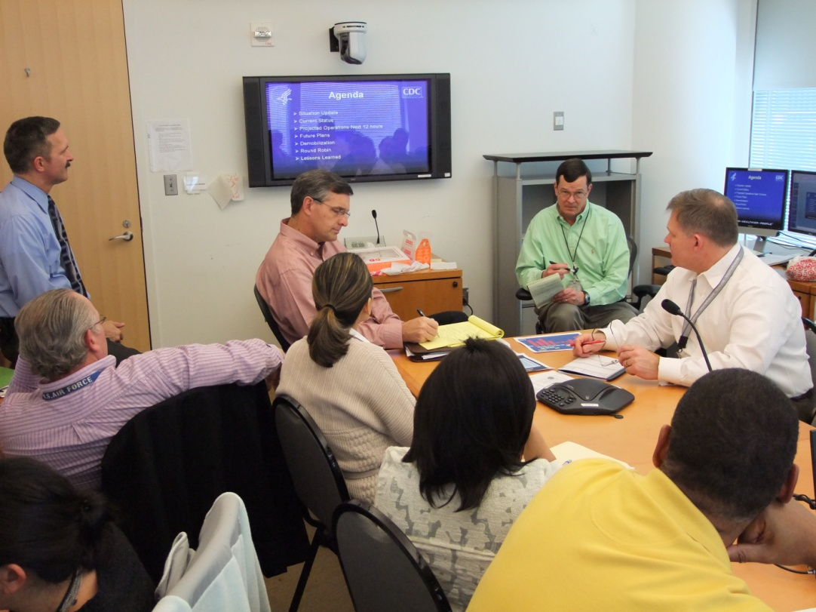

General Staff
Supports the scientific response for the incident
Provides Public Health messaging to the public
Manages the CDC emergency operations center (EOC)
Prepares and publishes CDC Incident Action Plans (IAPs) and Situation Reports (SITREPs)
Provides logistical and financial support for the incident response
Resources personnel and staffing for the incident response
Improves Situational Awareness by integrating and managing critical information
Notes:
Use this slide to highlight that these General Staff Sections are directed by the IMS Chief of Staff.

Slide 29
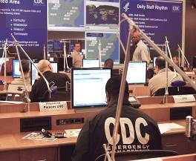
CDC’s Emergency Operations Center
Managed by the OPHPR Division of Emergency Operations
Functions as CDC’s command center for coordinating emergency responses to domestic and international public health threats
Staffed 24/7/365 to provide worldwide situational awareness
Coordinates CDC’s preparedness, assessment, response, recovery, and evaluation for public health emergencies
Serves as the central point of contact for state agencies reporting potential public health threats to CDC

Slide 30
Establish Pre-event Information Flow
  Develop routine daily information systems
  Daily reports
  Executive summaries
  Classified and unclassified briefings
  Develop “alert” messaging systems
  Spot Reports (SPOTREPs)
  201 Reports – early notification
  Phone and email
  Develop “follow-up” reporting
  Situational reports (SITREPs)
  Focused subject briefings
  Director update briefings
Teleconferences early
  Share information within organization
  Share information with other Federal agencies
  “Feed the information beast”

Slide 31
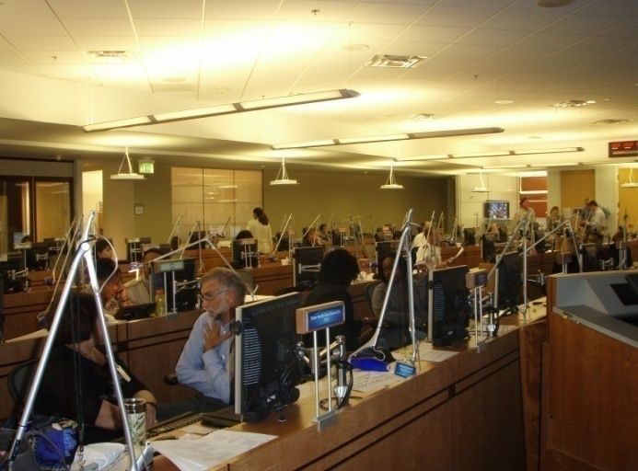
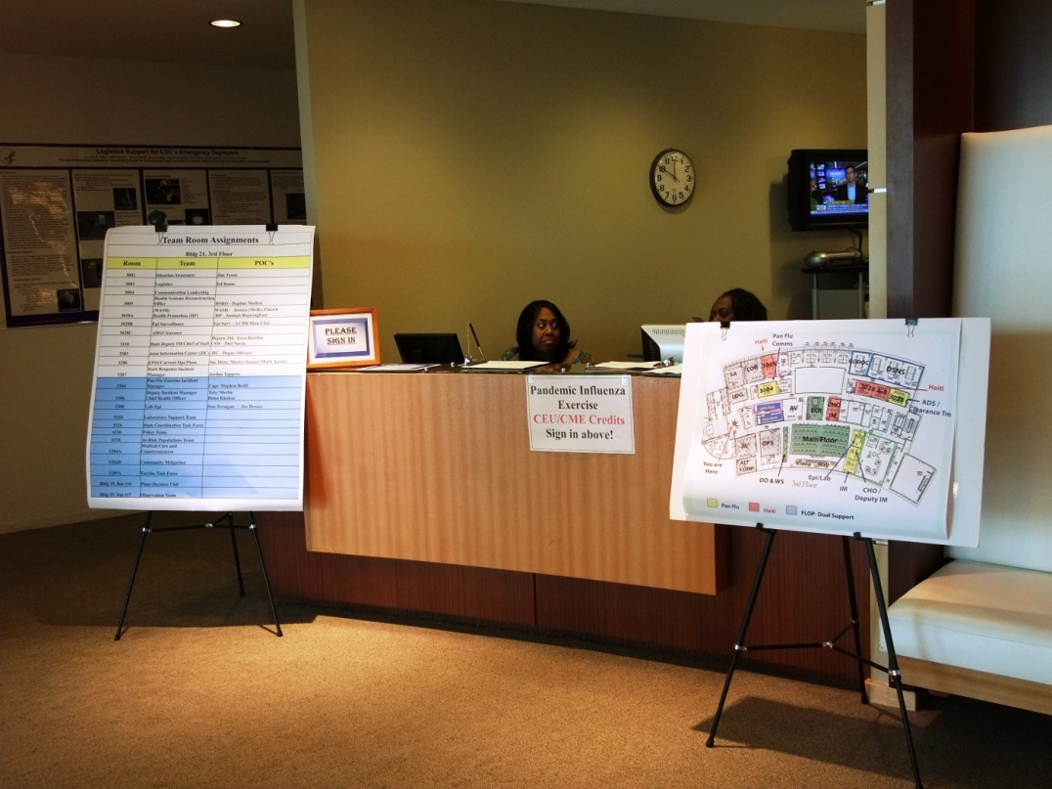
Operational Response Activities
  Develop event staff rhythm
  Produce leadership packets
  Track internal and external tasks
  Facilitate the development and maintenance of DCIRs
  Collaborate across sections and with other stakeholders
  Ensure event-related documentation is disseminated appropriately
  Coordinate meeting schedules and send calendar invitations to participants
  Coordinate space requirements
  Provide administrative support
Notes:
Daily Staff Rhythm – (event meeting schedule)
Leadership Packets – (memos, maps, SITREPS, executive summaries, etc.)
DCIRs – Things that are critical about this event. Things that require immediate IM notification
Taskings – (RFIs, RFAs, MAs) received, distributed & tracked
Tracking – primary role where we need help during major events
Collaborate – HHS, IRCT, FDA, EPA, DOD (Information exchange)
Documentation
Establish and maintain event distribution lists – Develop on-call lists.
Distribute SITREPS, briefing presentations, reports etc.
Calendar management
Working with Logistics to find places for people to work
Administrative Support – Always an area where volunteers are welcome
Tracking tasks is a major activity within the Current Operations Branch and each task is tied to a request of one form or another.
So now lets talk about how we handle Requests

Slide 32
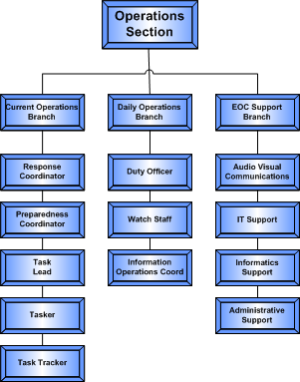
Operations Organizational Structure
  Operations Branch normally consists of 3 teams:
  Daily Operations Section
  Current Operations Section
  AV/Admin Support Section
Staffing and shift rotations are determined based on the response
Integrate staff into the event as the requirements change.
Additional staff comes from the CDC volunteer responder pool.
Notes:
As with all IMS Sections – Operations expands and contracts as needed. This is their basic organizational structure.
Permanently assigned staff can normally handle light weight responses (Level 3 activations)
Activations at higher levels (Level 2 & Level1), where extended shift coverage is required, trigger Operations to seek additional assistance.

Slide 33

Questions?
Office of Public Health Preparedness and Response
Division of Emergency Operations

Slide 34
Back-Up Slides

Slide 35
Office of Safety, Health, and Environment
Ensures the health, safety, and well-being of CDC deployed and activated personnel
Provides immunizations, vaccines and other prophylaxis for deploying individuals
Provides mental health and resiliency services for returning deployers and the IMS staff
The mission of the Office of Safety, Health and Environment is to empower workers and provide the tools needed for workers to be safe….

Slide 36
Security
Ensures the security of CDC responders through coordination with other law enforcement entities and through the provision of intelligence to appropriate decision makers in the agency
The Office of Security and Emergency Preparedness' vision is to provide dynamic, proactive, efficient, and effective security services ….

Slide 37
Liaison Officer (LNO)
Coordinates emergency response activities of federal and other partners with CDC and maintains communication between the CDC IMS Command Staff, federal and other partners, and other CDC response action officers in the CDC EOC
Lead LNO makes recommendations to the IM on needed LNO representation and coordinates with the providing organization
LNOs represent and coordinate with their parent organization to support the IM and staff
LNOs from CDC can be assigned to entities such as the DoS, DoD, ARC, FDA, International agencies, and HHS, or be assigned to CDC from these entities, or both
Notes:
DoS – Department of State
DoD – Department of Defense
ARC – American Red Cross
FDA – Food and Drug Administration
HHS – Health and Human Services
IMS – Incident Management System
EOC – Emergency Operations Center

Slide 38
Public Health Ethics
Helps to build and maintain credibility and public trust in public health recommendations
Fosters consensus and resolves values conflicts in an atmosphere of respect
Guides decision making when there is scientific uncertainty and many opinions about how to proceed
Increases awareness of the moral claims and values of community stakeholders, particularly of those most impacted by the public health recommendations.
The Public Health Ethics Unit works with programs to identify, analyze, and resolve ethical issues that arise in public health practice. ...

Slide 39
Strategic National Stockpile (SNS)
SNS is a repository of antibiotics, chemical antidotes, antitoxins, vaccines, antiviral drugs and other life-saving medical materiel.
The SNS mission is to deliver critical medical assets to the site of a national emergency.
SNS has both materiel and personnel assets available for rapid response. These include:
12-hour push packages (PPG) – 50-ton caches of pharmaceuticals, and medical supplies designed for rapid deployment.
Managed Inventory (MI) - maintained at facilities throughout the United States.
Federal Medical Stations (FMS) - DSNS will deploy personnel to provide technical assistance with set-up.
Special Support Missions - DSNS may provide specialized life-saving pharmaceuticals for individual use.
DSNS has the ability to deploy personnel simultaneously with the shipment of SNS assets.

Slide 40
Office of General Counsel (OGC)
Provides legal, technical and professional advice and recommendations to the IM and staff
Studies and interprets laws associated to the response
Manages the relationships with outside counsel
The Public Health Division of OGC advises the Public Health Service

Slide 41
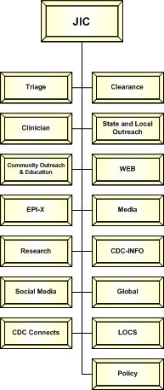

JOINT INFORMATION CENTER
Emergency Support Function (ESF) 15
Provides a coordinated Federal response to provide accurate, coordinated, timely, and accessible information to affected audiences, including governments, media, the private sector, and the local populace, including the special needs population.
The Joint Information Center (JIC), ensures the coordinated release of information under ESF #15.
Notes:
The Joint Information Center is a part of CDC EOC’s Command Staff structure in the “All Hazards” Incident Command system.

Slide 42
Joint Information Center
The Joint Information Center (JIC) ensures the coordinated release of information under ESF #15.
Designated to handle public information and Public Health Information
JIC structure is designed to work equally well for large or small situations expanding as needed
JIC gathers incident / event data
Analyzes public perceptions of the response.
Informs the public serving as the source of accurate and comprehensive information about the incident and the response to a specific set of audiences

Slide 43

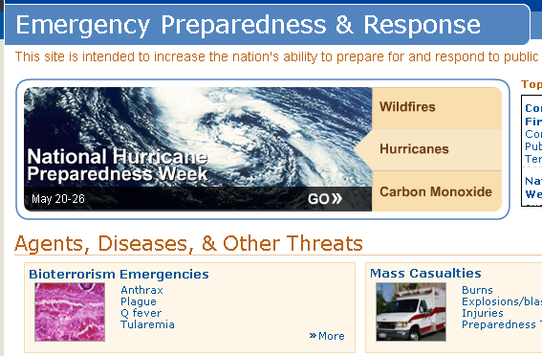
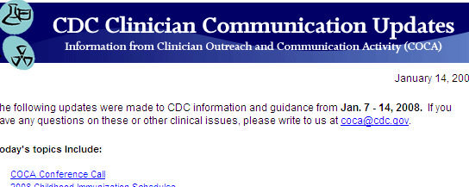

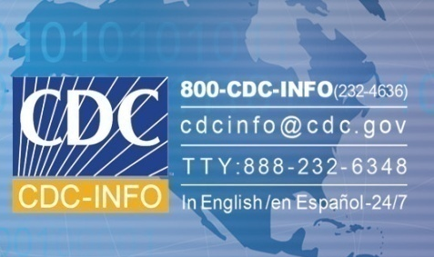

Joint Information Center
Consistent Dissemination of Information
News media
CDC Web site
CDC INFO
Health Alert Network
CDC Connects
Global Channels
Clinician List Serve and Conference Calls
National Public Health Information Coalition
EPI-X
This is an official
CDC HEALTH ADVISORY
Notes:
Channels of information

Slide 44


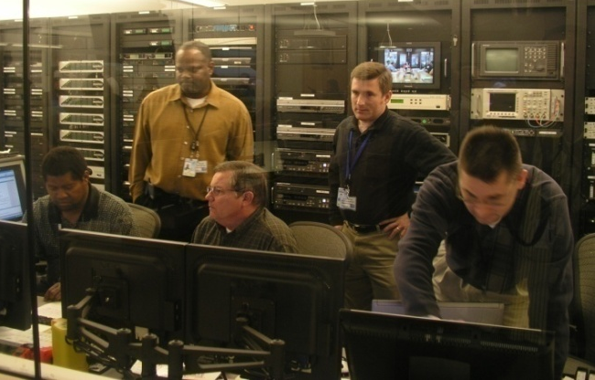
Operations Section
Manages the CDC’s command center (EOC) for coordinating emergency responses to domestic and international public health threats
Core Staff 24/7/365 to provide worldwide situational awareness
Coordinates CDC’s preparedness, assessment, response, recovery, and evaluation for public health emergencies
Serves as point of contact for state agencies reporting potential public health threats to CDC
Monitor DCIRs
Notes:
These are the basic functions of the Operations section on a daily basis.

Slide 45
Operations Organizational Structure
  Operations Branch normally consists of 3 teams:
  Daily Operations Section
  Current Operations Section
  AV/Admin Support Section
Staffing and shift rotations are determined based on the response
Integrate staff into the event as the requirements change.
Additional staff comes from the CDC volunteer responder pool.
Notes:
As with all IMS Sections – Operations expands and contracts as needed. This is their basic organizational structure.
Permanently assigned staff can normally handle light weight responses (Level 3 activations)
Activations at higher levels (Level 2 & Level1), where extended shift coverage is required, trigger Operations to seek additional assistance.

Slide 46
Operations Response Activities
  Develop event staff rhythm
  Produce leadership packets
  Track internal and external tasks
  Facilitate the development and maintenance of DCIRs
  Collaborate across sections and with other stakeholders
  Ensure event-related documentation is disseminated appropriately
  Coordinate meeting schedules and send calendar invitations to participants
  Coordinate space requirements
  Provide administrative support
Notes:
Daily Staff Rhythm – (event meeting schedule)
Leadership Packets – (memos, maps, SITREPS, executive summaries, etc.)
DCIRs – Things that are critical about this event. Things that require immediate IM notification
Taskings – (RFIs, RFAs, MAs) received, distributed & tracked
Tracking – primary role where we need help during major events
Collaborate – HHS, IRCT, FDA, EPA, DOD (Information exchange)
Documentation
Establish and maintain event distribution lists – Develop on-call lists.
Distribute SITREPS, briefing presentations, reports etc.
Calendar management
Working with Logistics to find places for people to work
Administrative Support – Always an area where volunteers are welcome
Tracking tasks is a major activity within the Current Operations Branch and each task is tied to a request of one form or another.
So now lets talk about how we handle Requests

Slide 47
During An Emergency Response:
Plans, Training, Exercises and Evaluations = IMS Planning Section
Reports to the Chief of Staff
Two distinct but collaborating units:
  Documentation Unit
  Plans Unit
Plans Science Officer from Scientific Response Section (SRS)
  Advisory
Notes:
Comment on the fact that when the EOC is activated and an Incident Management Structure is stood up, the Plans, Training, Exercise and Evaluation Branch immediately assumes the role of the Incident Management System’s Planning Section.
Inform the audience that we not only conduct the doctrinal incident action planning ,contingency planning, and transition planning functions, but we also conduct operational tasks such as situation reporting and maintaining event timelines.
Close with a note that the IMS Planning Section also begins collecting information for after action reporting and improvement planning, and conduct in-progress reviews at 30-45 day intervals during extended responses.

Slide 48
Planning Section Duties
Produce agency situation reports (SITREPs).
Develop agency incident action plans (IAPs).
Development of event-specific courses of action, short & long range planning, & contingency planning.
Facilitate the development of Agency response objectives.
Coordinate with the Scientific Response Section (SRS) to develop science-based objectives.
Collaborate across government planning sections.
Ensure event-related documentation is maintained for post-response investigations, inquiries, and reviews.
Conduct after action reviews.
Develop improvement plans.

Slide 49
Logistics Section Mission
To provide 24/7/365 logistics support: materiel, transportation, travel and equipping of deploying CDC personnel as well as procurement and financial management in the EOC, in support of CDC outbreak and emergency response activities to enable the successful accomplishment of the CDC mission.
    Note: Requests are channeled through the Logistics Section Chief
    eoclogchief@cdc.gov or (404) 553-7720

Slide 50

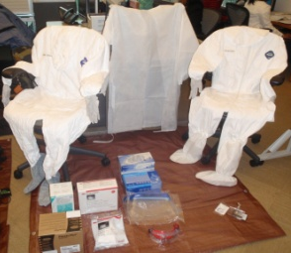
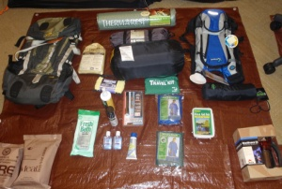
Logistics Section
Manages all event logistical support requirements
  Provide travel support (International and Domestic)
  Coordinates additional Space/Facility requirements
  Coordinate shipping and CDC aircraft to support operations
  Provide deployment equipment and supplies
    Order materiel/services through Procurement Branch
  Provide laboratory and medical supplies to CDC teams

Slide 51
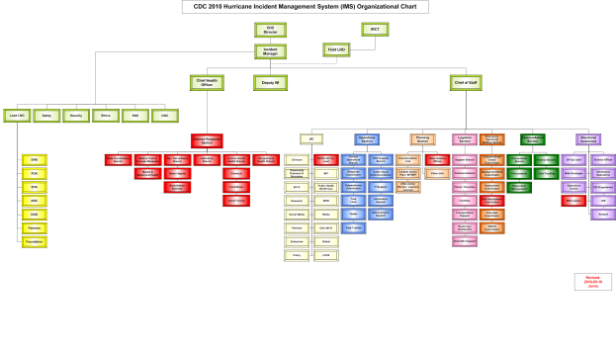
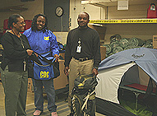
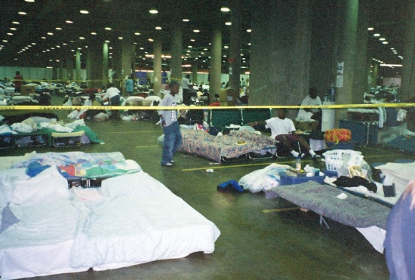
                Emergency Personnel Staffing Section (EPSS)
Resources, coordinates and ensures compliance with CDC instructions for deployments
Emergency Personnel Staffing Section
Commissioned Corps
Coordinator
Commissioned Corps requirements
OFRD
Deployment Brief
Coordinator
Organizes deployment briefings
Field Deployment
Activity
Coordinate with Emergency
Coordinators, OSHE, OSEP, Logistics
Enters/manages personnel into team
rosters in PWMS
Staffing
Coordinator Activity
IMS Staffing requirements and Rostering
IMS Org Charts
Certificates of Participation
EIS
Coordinator
Training requirements
Requirements for EIS officers
Notes:
SRS Science Reponse ????

Slide 52
Finance/Admin Section
Finance Branch
Staffed by Financial Management Office (FMO)
Provides event/incident related
    Cost Tracking
    Finance Policy
    Common Accounting Number (CAN) control
        Non-Stafford Act response is funded by CIO
        Stafford Act response funded via FEMA Mission Assignment (MA) process
Procurement Branch
  Staffed by Procurement and Grants Office (PGO)
  Provides market research assistance
    Procures supplies / services
    Deploys Federal Contracting Officers
Finance / Admin
Section
Procurement
Finance Branch
Branch
Procurement
Cost Tracking
Requisition Management
Finance
Policy
Notes:
52

Slide 53
Situation Awareness

Slide 54
Situation Awareness
Improve vertical and horizontal information sharing
Provide support and collaboration to CDC IMS personnel
Provide analytical and geospatial information products
Develop and maintain Knowledge Management and social-networking¹ capabilities
Collect, coordinate, process and analyze disparate data to produce actionable information to support operational needs, and
Monitor worldwide “All Hazard” conditions for possible CDC international or national response operations
¹ Limitations: Associated with CDC response activities, for all other social-networking, you are on your own.
Notes:
54

Slide 55
Situational Awareness
Improve vertical and horizontal information sharing
Provide support and collaboration to CDC IMS personnel
Provide analytical and geospatial information products
Develop and maintain Knowledge Management and social-networking¹ capabilities
Collect, coordinate, process and analyze disparate data to produce actionable information to support operational needs, and
Monitor worldwide “All Hazard” conditions for possible CDC international or national response operations

